Slide 1





ECG Non-invasive Heart Disease Prediction

Slide 2
Table of contents
Introduction of the Dataset
Problem Statement
Data Preparation & Cleaning
Exploratory Data Analysis
Machine Learning
Demonstration Model
Conclusion
2

Slide 3



Introduction of the Dataset
Comprehensive Real-World Data:
This dataset combines five globally recognized clinical datasets: totaling 1,190 observations across 11 common features.
Clinically Meaningful Features
Features such as ChestPainType, ExerciseAngina, ST_Slope, and Oldpeak reflect real diagnostic signals used in stress tests and ECG evaluations.
ExerciseAngina: discomfort when heart receive less oxygen
ST_Slope: the slope of the peak exercise ST segment
Oldpeak: reduced blood flow to the heart muscle during exercise
MEASURED BY ECG
3

Slide 4
Problem Statement
How can we combine conventional clinical indicators with ECG-derived features to more accurately and accessibly predict heart disease?
Heart disease often detected using invasive techniques eg blood tests, cholesterol checks, or chest X-rays
We wanted to know whether non-invasive ECG-derived features, where it could accurately predict heart disease
We hope to validate if ECG features could offer reliable predictions
4

Slide 5
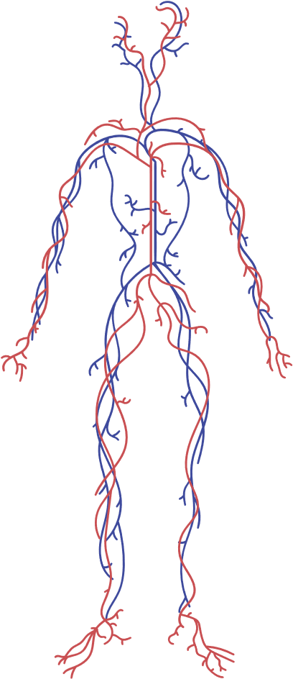




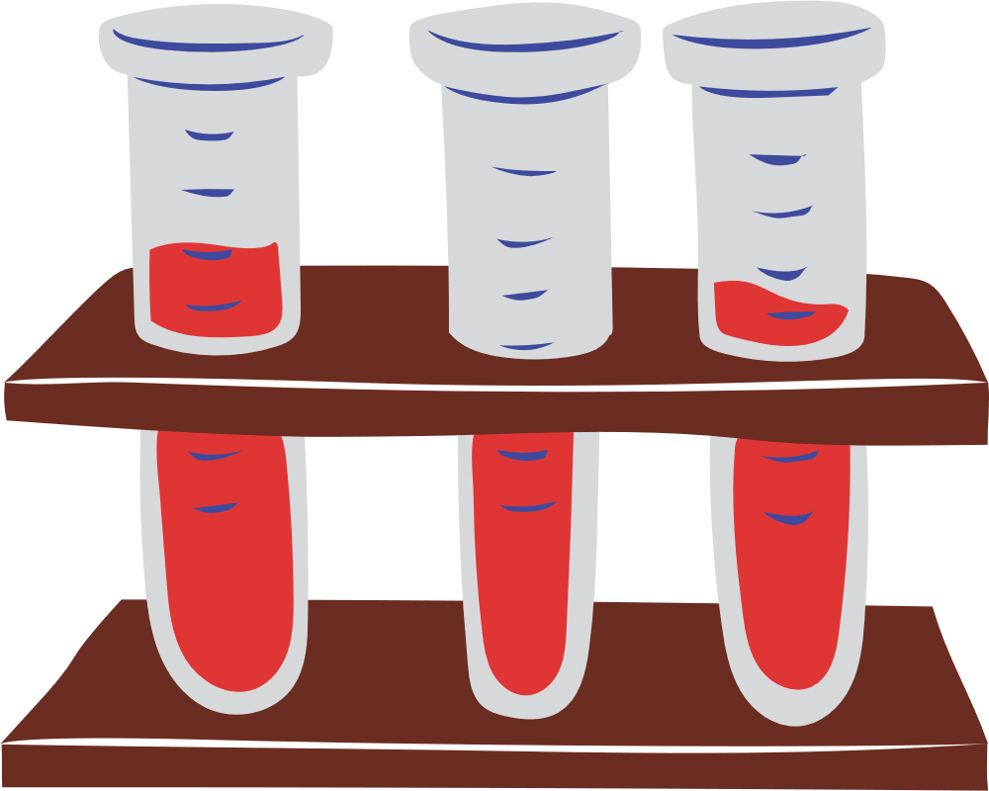

DATA PREPARATION & CLEANING
5

Slide 6
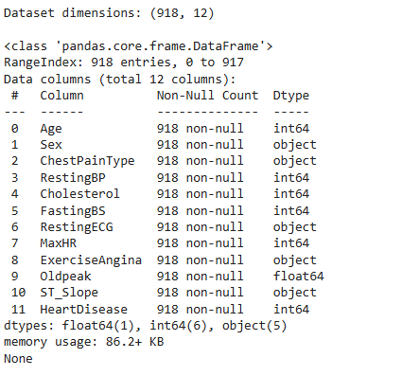
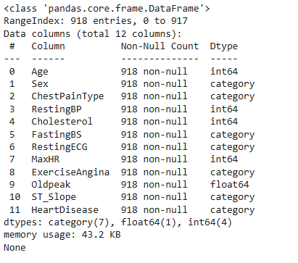

Initial Preparation
check the data type of the variables and convert objects into categorical data
6

Slide 7
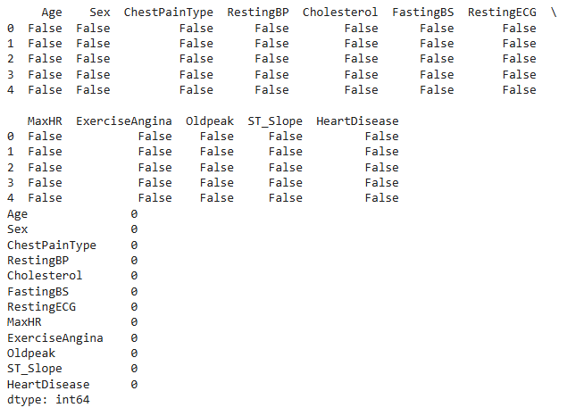
Data Cleaning
Checking of missing values from the variables
7

Slide 8
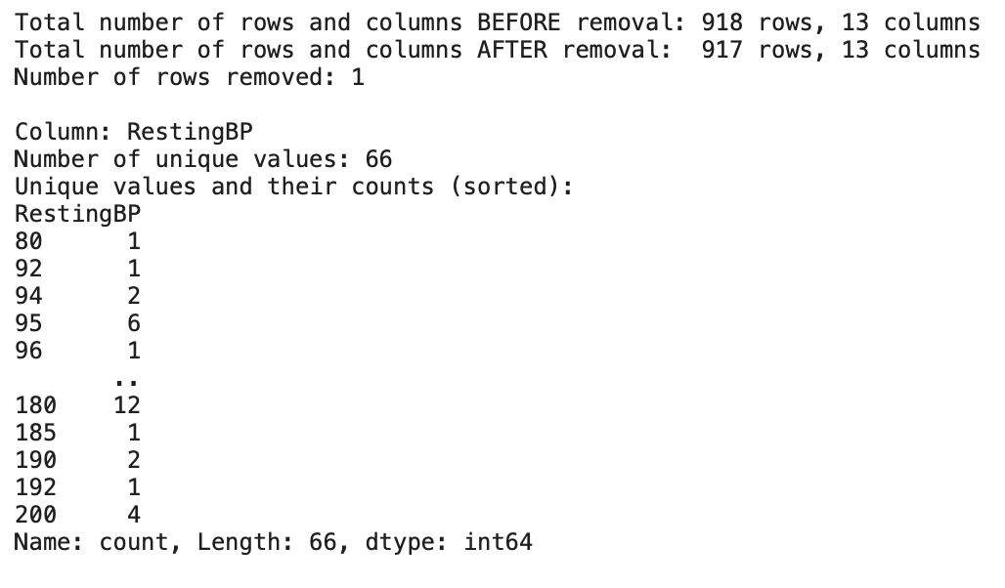
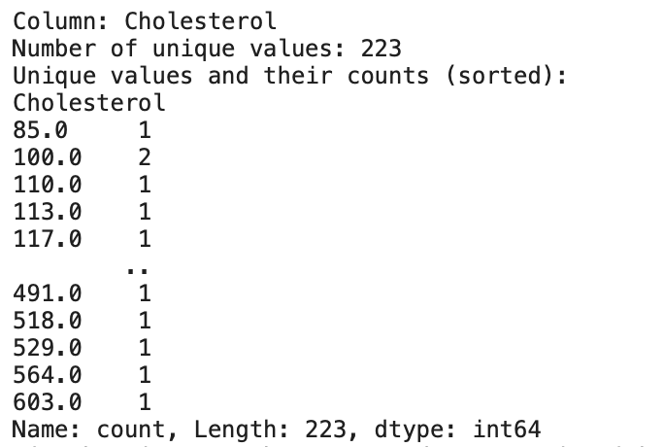
Data Cleaning
Checking of unique values for each variables
Removing invalid entries: one row from RestingBP and Cholesterol
Checking of duplicated data in the variable:
No duplicated rows found in the dataset.
8

Slide 9
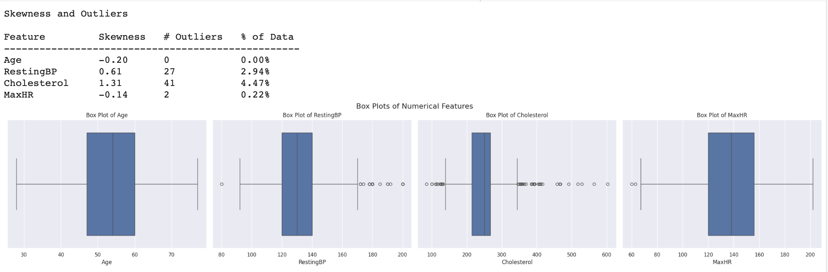
Data Cleaning
Checking of Checking of outliers and skewness
9

Slide 10
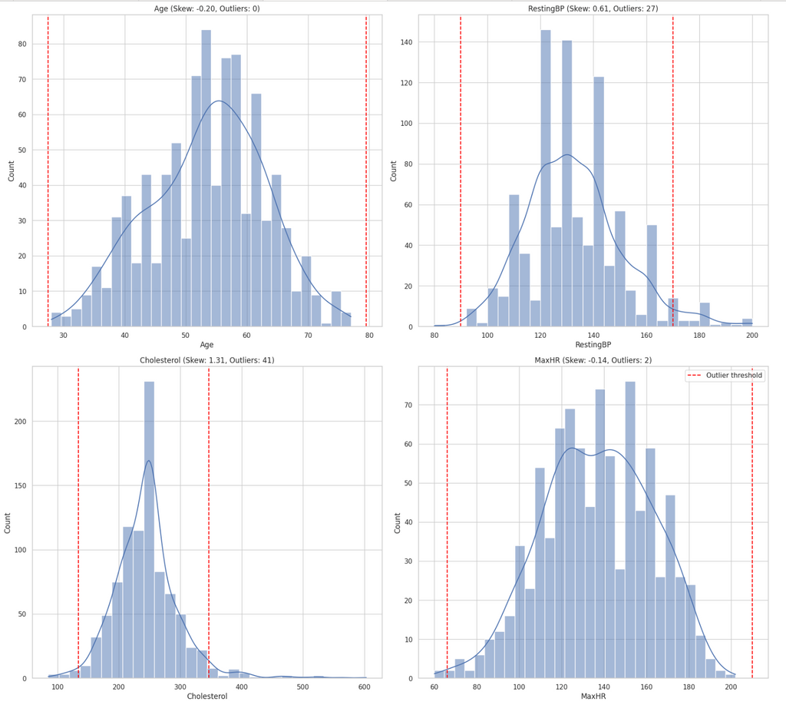
Data Cleaning
Visualizing the distribution and outliers with KDE after data cleaning
10

Slide 11
Exploratory Data Analysis
11

Slide 12

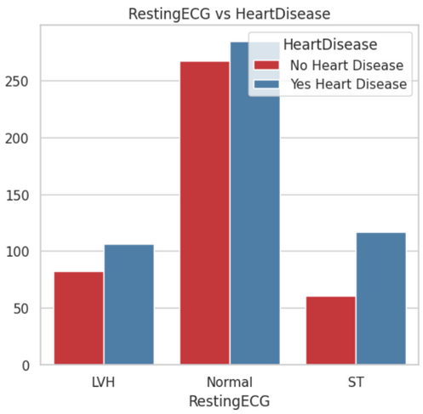
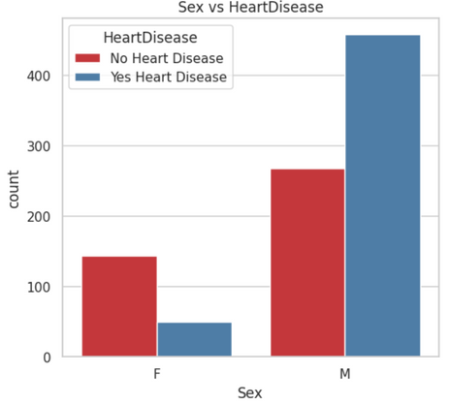
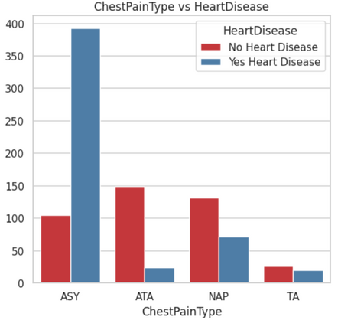
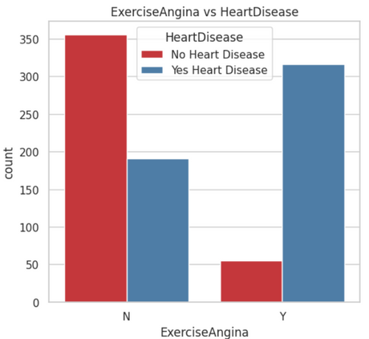
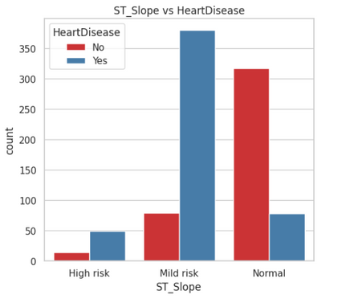
Categorical against Heart Disease
Sex
ChestPainType
RestingECG
ExceriseAngina
ST-Slope
12

Slide 13

Categorical against Heart Disease
ST Slope: Heart’s response to exercise
Up: Healthy heart response
Flat/Down: Signs of restricted blood flow
Inference made from the data
Males are more likely to suffer from Heart Disease
Asymptomatic individuals increase the risk of Heart Disease
Exercise plays a role in reducing heart disease
Asymptomatic: No symptoms despite underlying medical conditon
Exercise Angina: Chest pain during exercise
Yes: Experience angina
No: Did not experience angina
13

Slide 14
Chi-square and Cramer’s v tests
Chi-square Test
The association between 2 variables
Value:
<0.05 (Significant Relationship)
>= 0.05 (No Significant Relationship
Finds out the significance of a variable
Cramer’s V Rule
The strength of association between 2 variables
Value:
Between 0 and 1 (strongest)
Finds out the importance of a variable
14

Slide 15
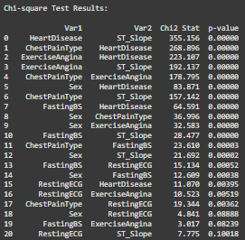
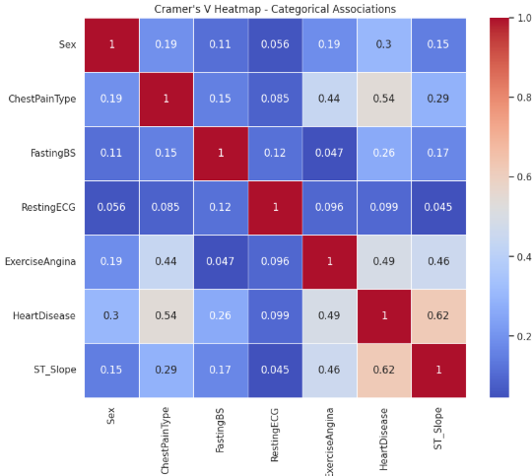

Chi-square and Cramer’s v test
15

Slide 16
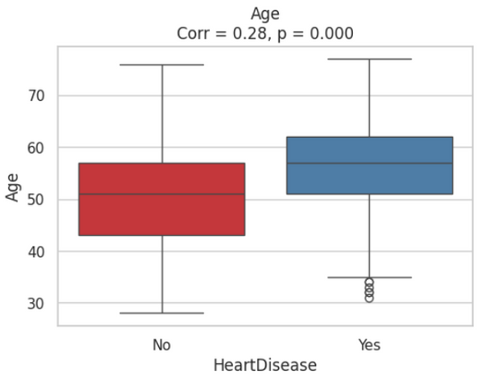
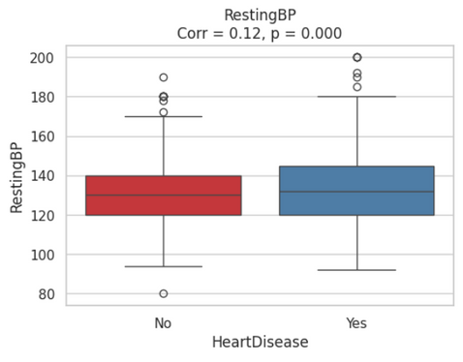
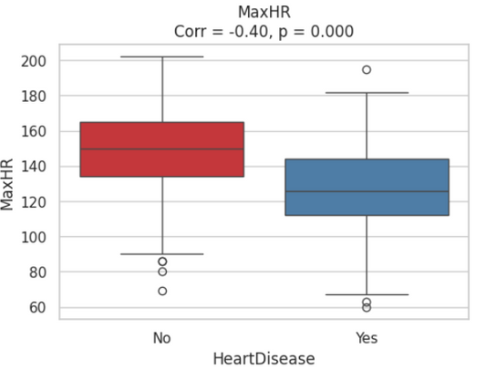
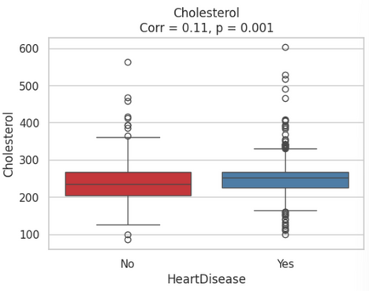
Numerical against Heart Disease
Age
RestingBP
Max HR
Cholesterol
16

Slide 17
Numerical against Heart Disease
Inference made from the data
The older people get, the more likely of heart disease
Max Heart Rate plays a role in heart disease detection
Low Heart Rate: indicates good cardiovascular fitness. Thus a healthy heart
17

Slide 18
Machine Learning
18

Slide 19

Decision Tree
Random Forest
Logistics
Regression
Ensembling
Model
XGboost
Evaluation
Machine
Learning
Models
Predict the risk of heart failure based on patient clinical data (binary classification).
We design relative optimization for each model.
19

Slide 20
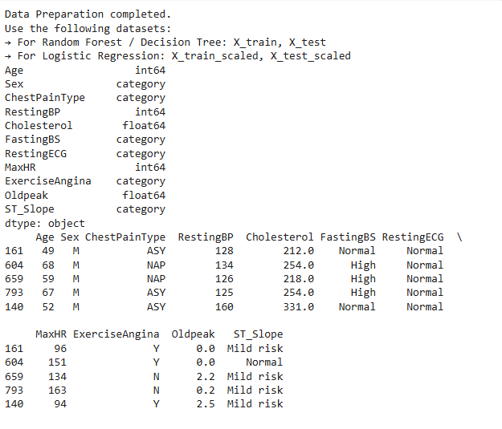
Data Preprocessing Pipeline
Encode categorical variables
Define features and target
Train-test split (stratified)
Normalize numeric features
(for logistic regression only)
20

Slide 21
How we choose models? Here is the flow...
Logistics Regression: most common model, but assume linear correlation
Decision Tree: can handle non-linear variables, perform not very well (over-fitting etc.)
Random Forest: can seen as essemble of DT, better perfomance by taking average from each DT
XGboost: similar to RF but can learn and reduce error from tree to tree
Essembling Model: try to take advantage from models we have and seek more stable and accurate performance
We learn and select ML models step by step,
to find the most suitable model for our prediction!
21

Slide 22
Evaluation Design and Visualization
Metrics Used:
Accuracy
Precision / Recall / F1-Score
ROC AUC Score
Confusion Matrix
Visualizations Included:
ROC Curves (multi-model comparison)
Confusion Matrix heatmaps (for each model)
Bar chart comparing Precision / Recall / F1
Recall is emphasized due to the healthcare context: false negatives are riskier than false positives.
Therefore, we also plot the PR Curve which is useful for understanding model performance on the positive class when data is imbalanced.
22

Slide 23
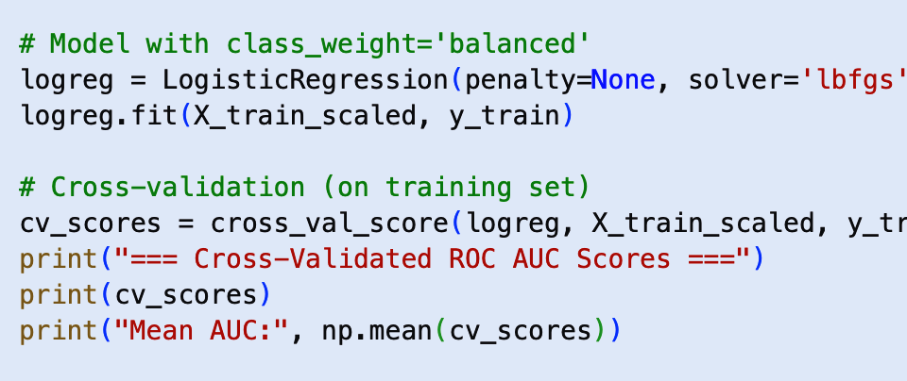
Logistics Regression
Features:
Linear model via sigmoid function
Training Details:
Used class_weight='balanced' to handle class imbalance
Performed cross-validation on training set
Strengths:
High interpretability
Efficient to train
Limitations:
Assumes linear relationship
May underperform on complex, non-linear patterns
Most widely accepted model
in medical research
and clinical settings.
23

Slide 24
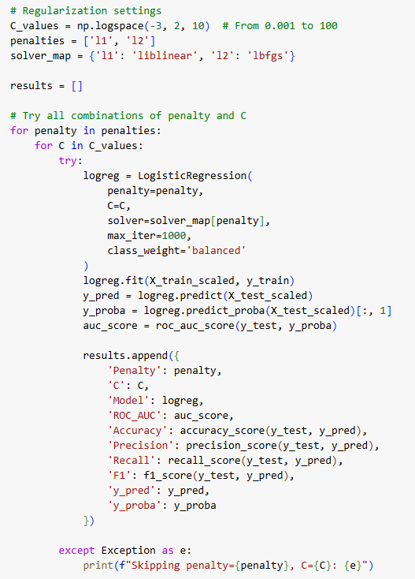
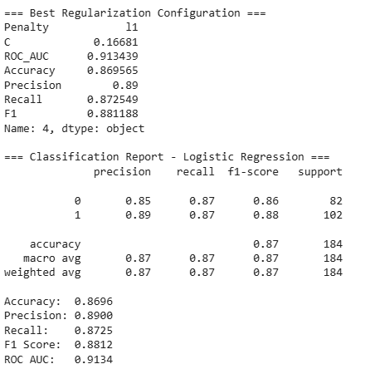
Training Logistics Regression
Logistic regression with regularization
24

Slide 25
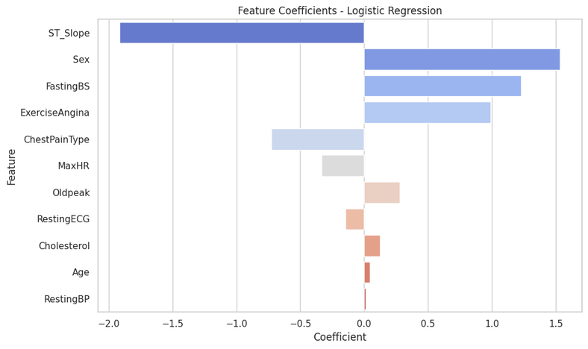
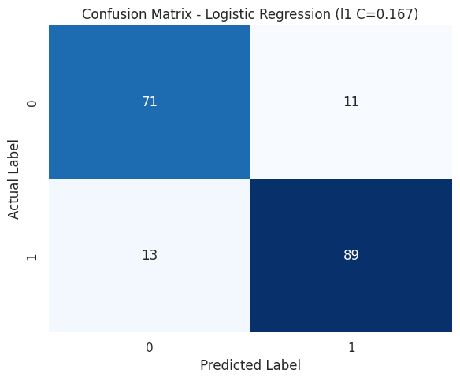
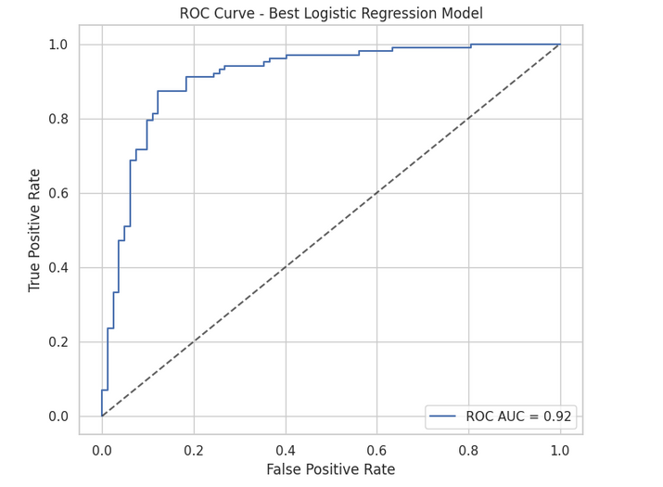
25

Slide 26
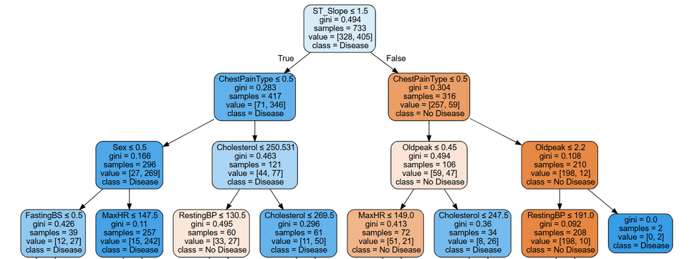
Decision Trees
Features:
Captures non-linear relationships
Intuitive and easy to visualize
Strengths:
Interpretable model structure
Handles missing values and outliers well
Limitations:
Prone to overfitting on small data
Unstable with small variations in data
26

Slide 27
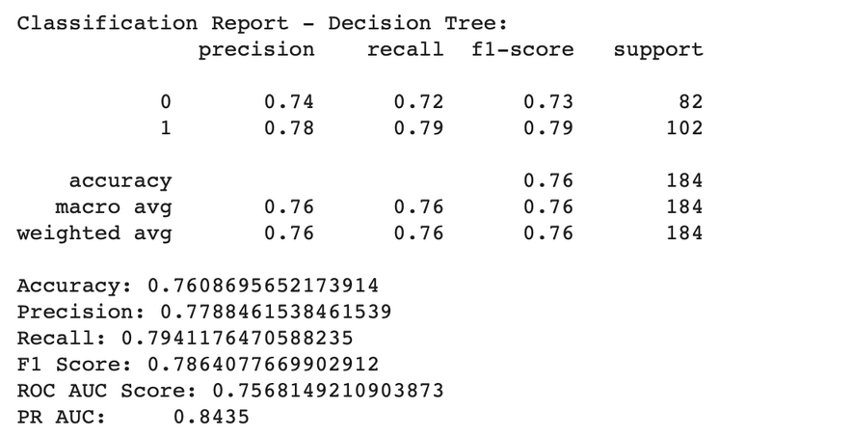
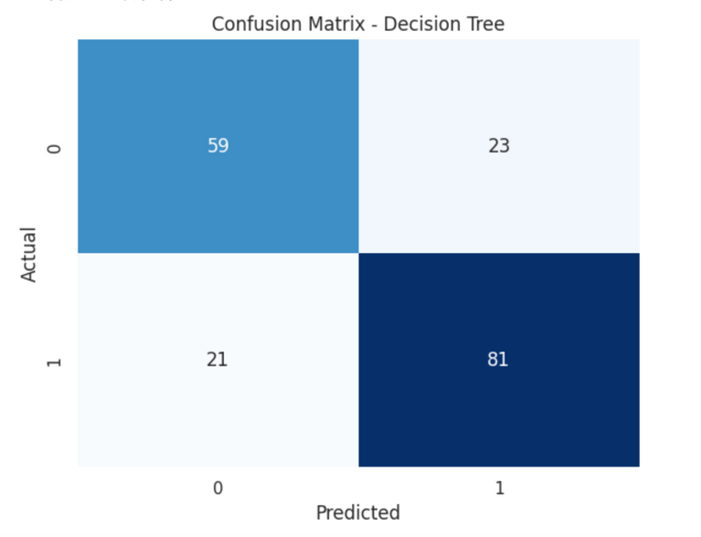
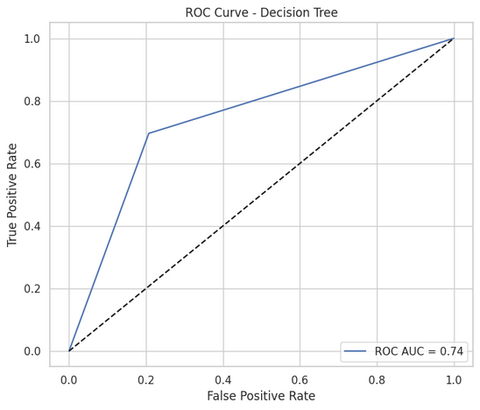
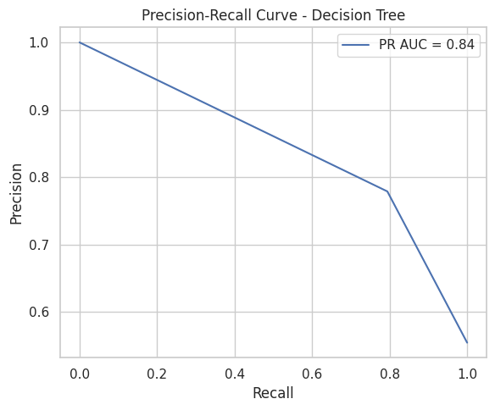
27

Slide 28
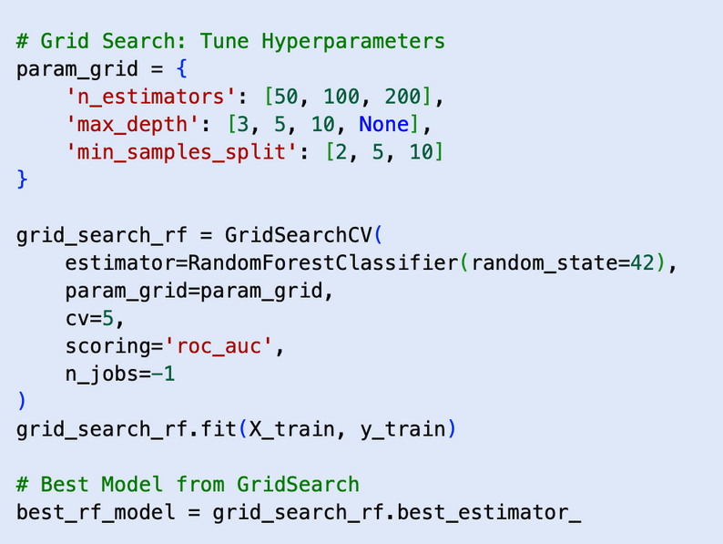
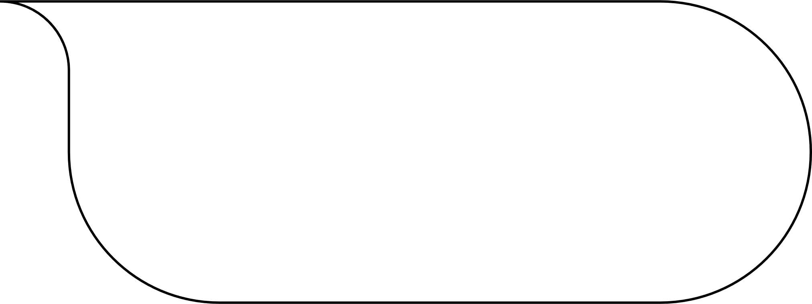
Random Forest
Feature:
Ensemble of multiple decision trees
Reduces variance and overfitting
Training Details:
Hyperparameter tuning via GridSearchCV
Tune n_estimators, max_depth, max_features
Strengths:
Robust and performs well on diverse data
Provides feature importance
Limitations:
Less interpretable than single tree
Slower to train
“We used Grid Search to automatically test different values for parameters like n_estimators and max_depth, and chose the combination that performed best on validation data.”
28

Slide 29
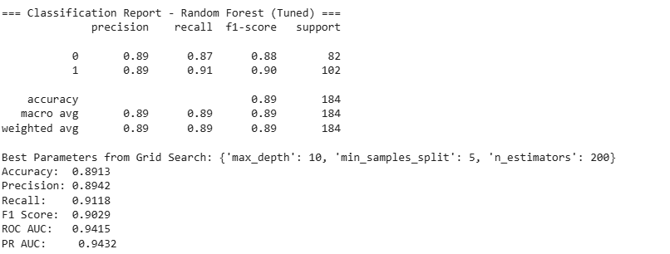
29

Slide 30
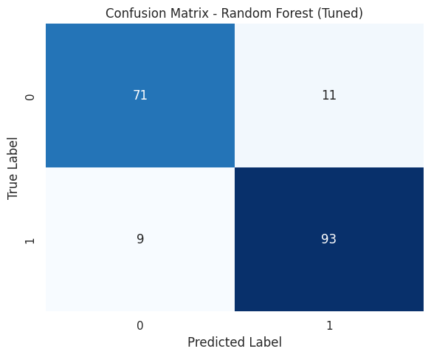
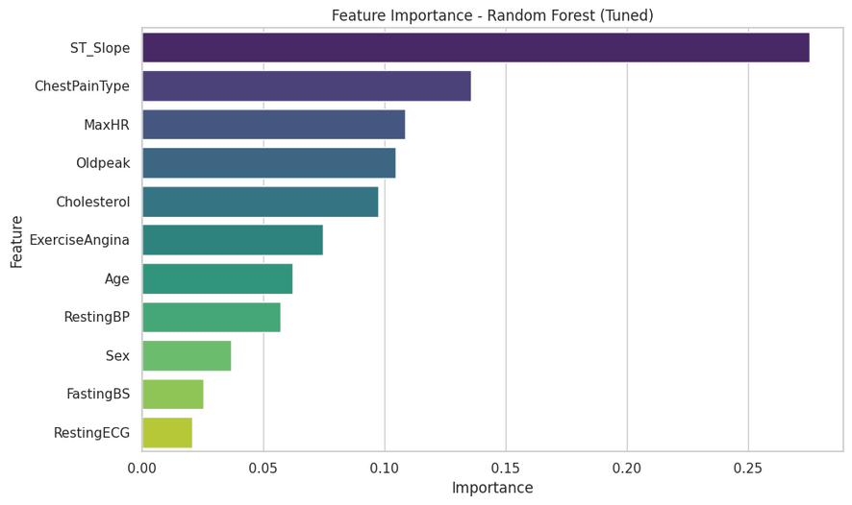
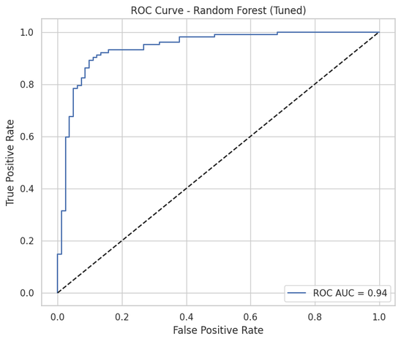
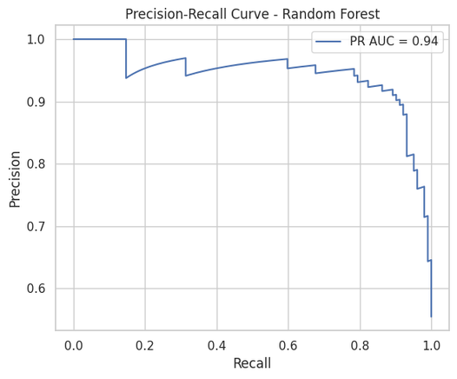
30

Slide 31
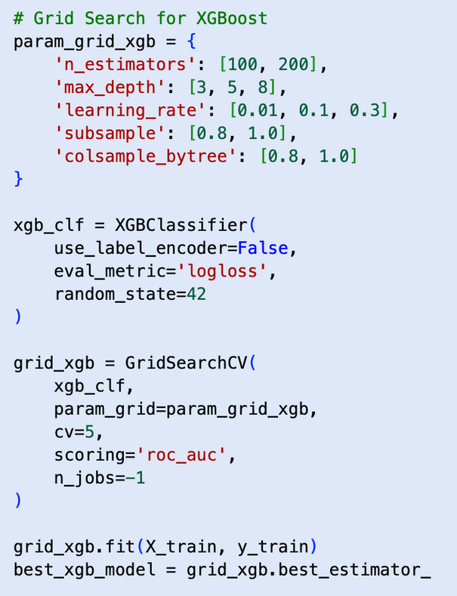
XGBoost
Features:
Captures complex non-linear patterns
Incorporates tree pruning and early stopping
Training Details:
Tune n_estimators, learning_rate, max_depth, subsample
(grid search)
Strengths:
High predictive performance on structured data
Handles class imbalance well with scale_pos_weight
Built-in handling for missing values
A very strong model!
Limitations:
Can be slow and expensive
31

Slide 32
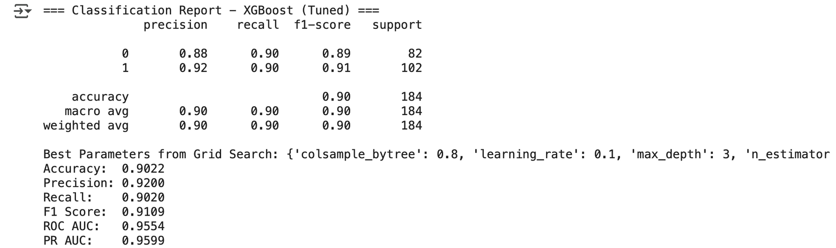
32

Slide 33
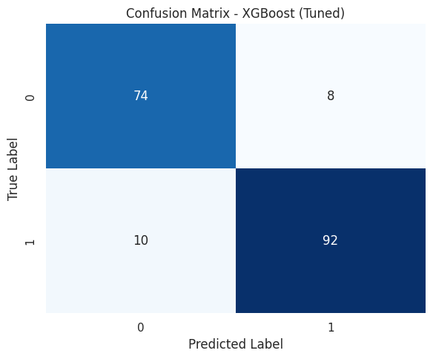
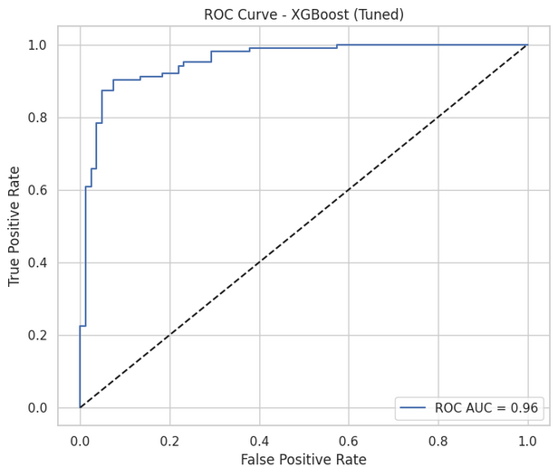
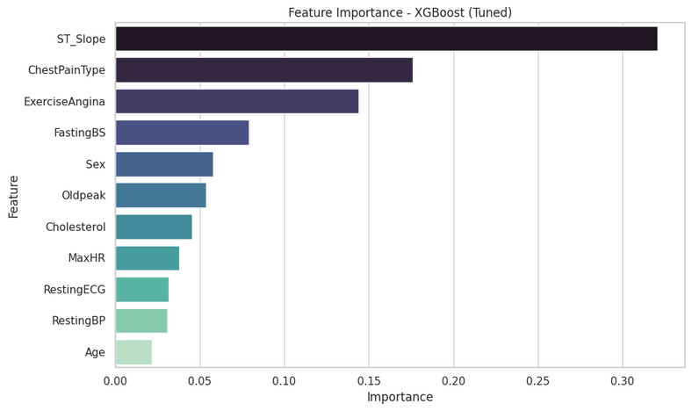
33

Slide 34
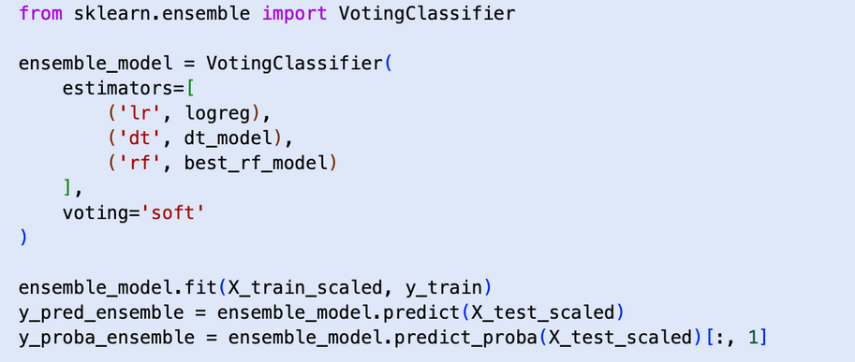
Ensembling Model from DT,RF,LR with soft voting
Features:
Combines DF, RF, LR, using Soft Voting to get the possibility
Training Details:
Tried combining top individual models using VotingClassifier
Strengths:
Potential to leverage strengths of different models
Can improve robustness in imbalanced or noisy datasets
Limitations:
Added computational complexity, without better performance
Risk of overfitting without enough data
More models ≠ better results without proper tuning
“We chose not to include XGBoost in the ensemble because it already functions as a powerful boosted model. Combining it with other models added complexity without clear performance gains. Moreover, it provides similar information to RF.”
34

Slide 35
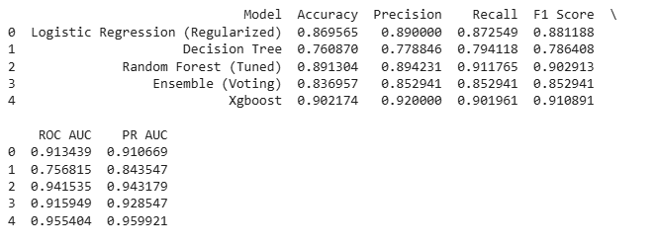

Evaluation
XGBoost and Random Forest
achieved the highest performance,
But they also have
higher time and space complexity.
Logistics Regression also performed well, with a lower complexity.
Ensemble model provided stable performance
but did not outperform the best single models.
35

Slide 36
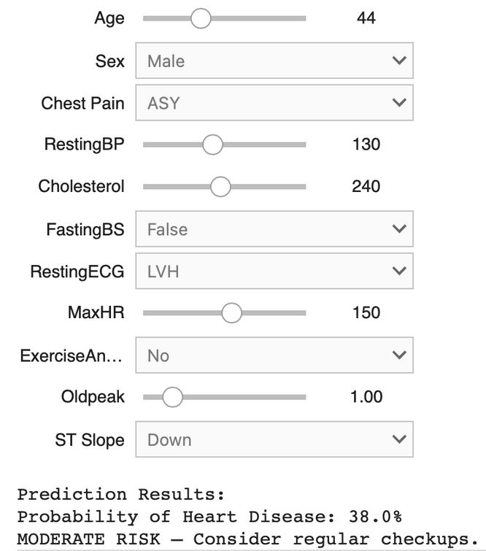
Model Demo
will automaticly return the predicted probability and risk level (low, medium, high) based on the user input
using XGboost here for demo
36

Slide 37
Learning Outcomes
01
02
03
Gained proficiency in data preprocessing techniques and learn EDA to identify the patterns and relationships between different variables.
Developed skills in implementing and comparing classification models like Logistic Regression, Random Forest, XGBoost and emsembling model
Learned how to evaluate model performance using metrics like accuracy, precision, recall, and F1-score
37

Slide 38
Something Interesting
ST_Slope, ChestPainType and ExerciseAngina have the highest accuracy in XG boost while Age has the lowest which is interesting. Maybe it is because the dataset is skewed towards people in the age of 50-70 and people aged 20-50 are not well represented in the dataset.
38

Slide 39
Conclusion + Reflection
Aim
Our aim was to explore whether ECG-derived features can serve as strong indicators for detecting heart disease.
-> Highlights the importance of non-invasive ECG signals in early diagnosis
-> Implement a model based captured by ECG for prediction
Outcome
-> ST_Slope was most strongly correlated with heart disease followed by Chest Pain Type and Exercise Angina.
-> ST_Slope consistently ranked as one of the top predictors
-> Validated our EDA insights, ML predictions and research papers
39

Slide 40
Refences
https://www.nhs.uk/conditions/heart-attack/diagnosis/
https://www.health.harvard.edu/heart-health/can-a-smart-watch-diagnose-a-heart-attack
https://litfl.com/st-segment-ecg-library/
https://www.mayoclinic.org/tests-procedures/ekg/about/pac-20384983
https://www.kaggle.com/datasets/fedesoriano/heart-failure-prediction/data
40

